Slide 1
Strings
Creative Commons Attribution-NonCommercial-ShareAlike 3.0 Unported License. http://creativecommons.org/licenses/by-nc-sa/3.0/
Written by Rachel J. Morris, last updated 2015-01-14

Slide 2

Strings
We've been using strings a little bit in our programs so far,
But we haven't looked at a lot of the things that C++ strings can do.
The C++ string is an object that has a set of functionality that can be really handy!
“while not done”

Slide 3
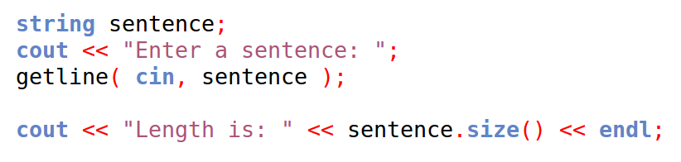
String size
We can get the size of the contents of a string by using the .size() function.
“while not done”

Slide 4
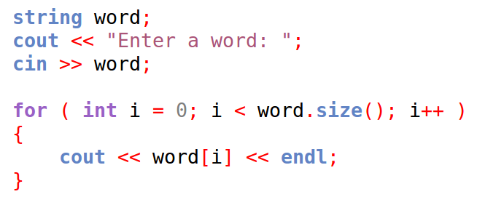
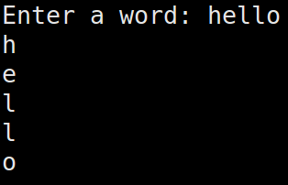
Iterating through strings
The square brackets,
[ ]
is the subscript operator in C++.
We can get single chars from a string by using it like an array.

Slide 5
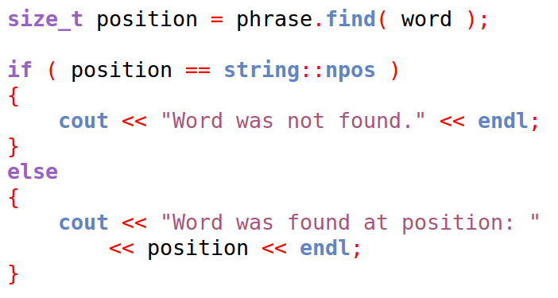
Finding substrings
We can use the find function to find a substring within a string.
find returns the position that the (first) substring is found.
If no substring is found, it is set to the value of string::npos.
Note that size_t
Is an alias of an unsigned integer.

Slide 6
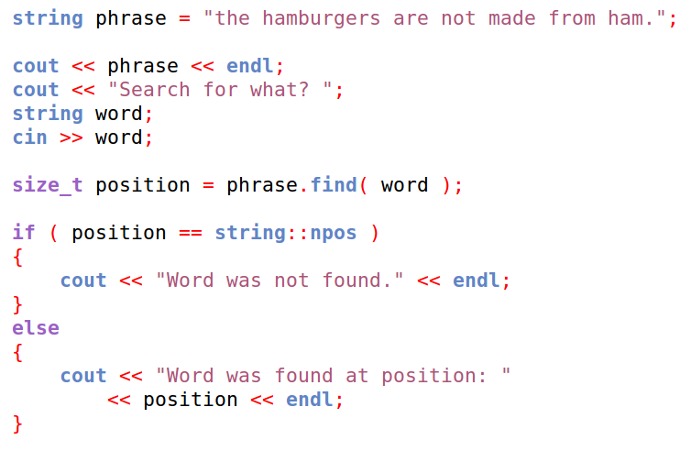


Finding substrings
Only the position of the first found match is returned.

Slide 7
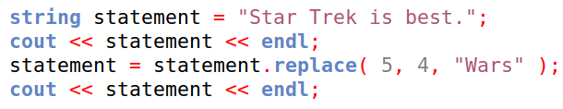

String Replace
We can replace portions of a string with the replace function.
We pass in the position and the length that we want to replace, and the string of what it should be replaced with.
0 S
1 t
2 a
3 r
4
5 T
6 r
7 e
8 k
9
10 i
11 s
“Trek” begins at position 5 and is 4 characters long.

Slide 8
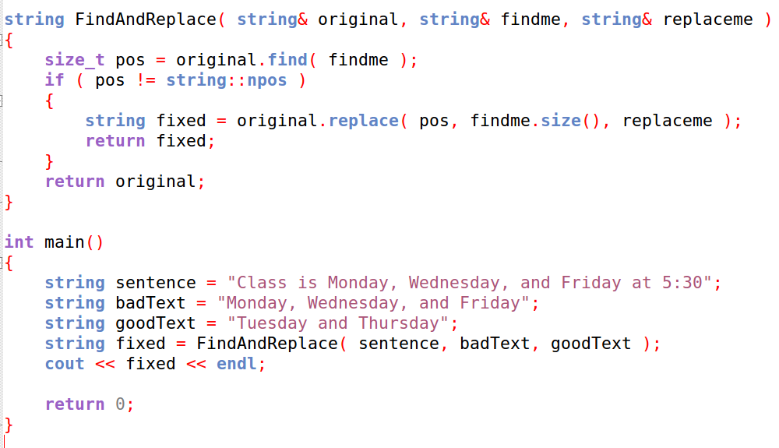
String Find and Replace
We can combine the find and replace function to write a function that will swap out one string with another string.

Slide 9
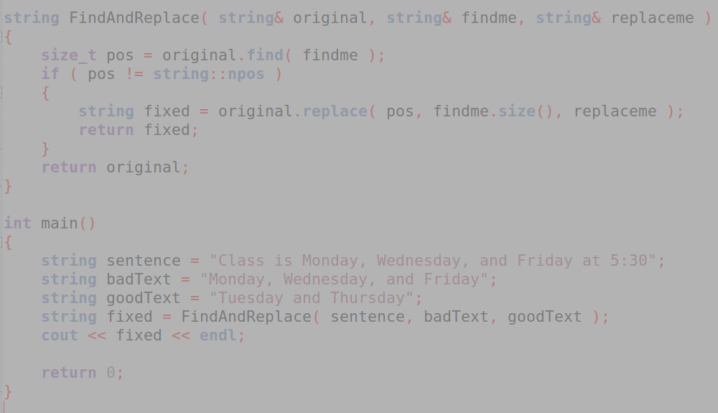
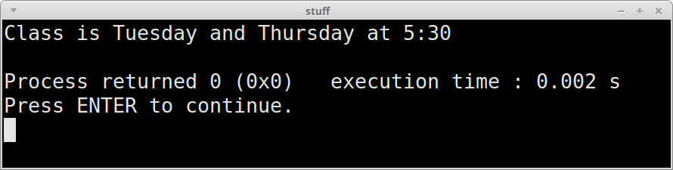
String Find and Replace
We can combine the find and replace function to write a function that will swap out one string with another string.

Slide 10
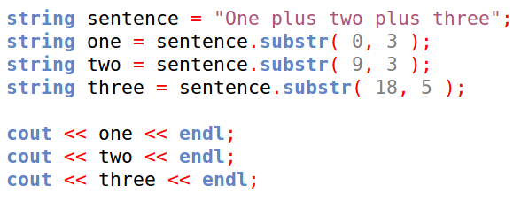

Substring
We can get a substring from a string with the substring function, which requires a starting position and length.

Slide 11
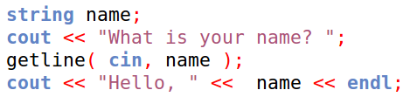

Get a line
getline is not a function that belongs to the string class, but it can be used to get a line of text from the user and store it in a string.

Slide 12
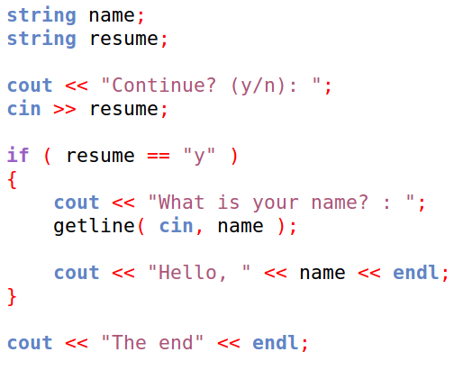
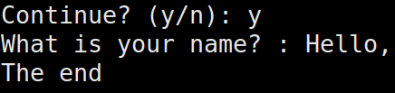
Get a line
Note that if you're inter-mixing your input methods, you might need to use cin.ignore() before you change, or you might get wonky results:
It totally skipped the getline statement!

Slide 13
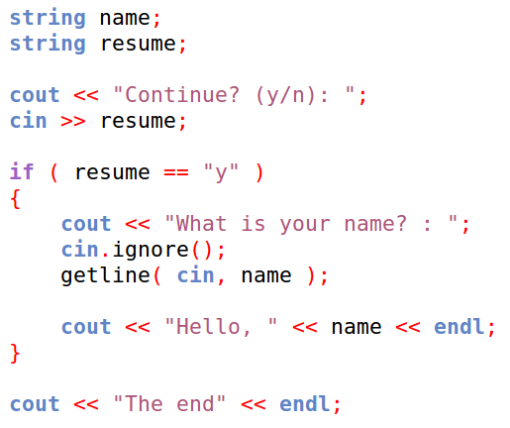
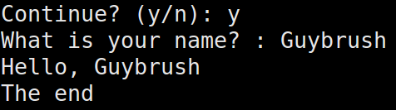
Get a line
Note that if you're inter-mixing your input methods, you might need to use cin.ignore() before you change, or you might get wonky results:
Now it's OK!

Slide 14
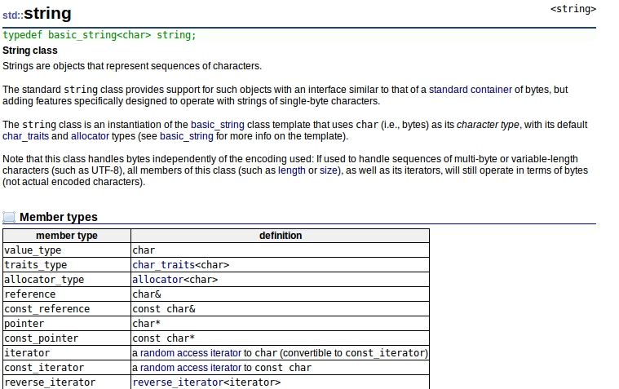
Strings
You can find out more about the string class and its functions at
http://www.cplusplus.com/reference/string/string/

Slide 15
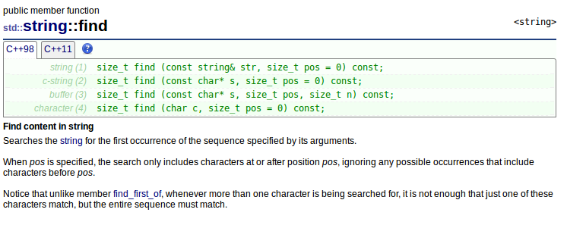
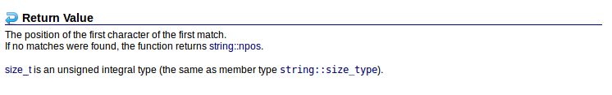
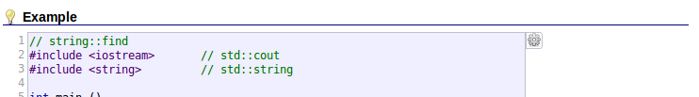
Strings
Most of the pages about functions will have a parameter list and sample code.

